Slide 1


Capstone Project Title/Name
By
Pranav M [RA2211030010093]
Chithresh A [RA2211030010073]
Mentor : John Peter
College Name – SRM Institute of Science and Technology
Notes:
Let's delve deeper into the exciting world of sustainability and AI.
In this chapter, we'll explore how artificial intelligence can be a powerful tool for addressing environmental challenges and promoting sustainable practices. We'll discuss specific applications of AI in various sectors and analyze its potential to drive positive change.
Get ready to discover the innovative ways AI is contributing to a more sustainable future!

Slide 2

Project Objectives
Problem Statement
Project Overview – Introduction
End Users
Wow Factor in Project
Modelling/Block Diagram/Flow of Project
Result/outcomes
Conclusion
Future Perspective
Notes:
Let's outline what you'll learn in this presentation.
By the end, you'll be able to:
Understand how AI helps solve problems like climate change, resource depletion, and biodiversity loss.
Identify key AI uses in energy efficiency, waste management, and climate change.
Analyze AI's role in sustainable agriculture and cities.
Evaluate AI's use in environmental monitoring using satellites, real-time data, and predictions.
Apply AI strategies in logistics and transportation to make them more sustainable.
Get ready to discover how AI can help create a greener future!

Slide 3
Problem Statement
Manual analysis of system logs is time-consuming and inefficient.
Existing tools provide raw threat data but lack actionable insights.
Delayed threat detection increases cyber risk and slows incident response.
Notes:
Sustainability and AI
Sustainability is important because it helps meet our needs now and in the future. It includes protecting the environment, reducing pollution, and improving economic and social well-being.
AI can help us achieve sustainability. AI can process data, make predictions, and optimize systems to solve problems like resource management, environmental conservation, and energy efficiency.
Examples:
Smart grids: Reduce energy consumption.
Agriculture: Optimize water and fertilizer use.
Biodiversity: Monitor wildlife to protect biodiversity.
AI is a powerful tool for creating a more sustainable future.

Slide 4
Project Overview - Introduction
Automates cybersecurity log monitoring and threat analysis using AI and automation workflows.
Collects logs from Suricata on the local PC and forwards them to Wazuh.
Logs are categorized by attack level and passed to n8n automation via Cloudflare Tunnel.
AI agents enrich logs using Gemini API, VirusTotal, and AbuseIPDB, then deliver human-readable alerts to a Telegram bot.
Reduces manual effort, improves accuracy, and speeds up incident response.
Notes:
Sustainability and AI
Sustainability is important because it helps meet our needs now and in the future. It includes protecting the environment, reducing pollution, and improving economic and social well-being.
AI can help us achieve sustainability. AI can process data, make predictions, and optimize systems to solve problems like resource management, environmental conservation, and energy efficiency.
Examples:
Smart grids: Reduce energy consumption.
Agriculture: Optimize water and fertilizer use.
Biodiversity: Monitor wildlife to protect biodiversity.
AI is a powerful tool for creating a more sustainable future.

Slide 5
End Users
Security analysts monitoring IT infrastructure.
IT teams responsible for incident response.
Small businesses or individuals needing automated threat detection.
Notes:
Sustainability and AI
Sustainability is important because it helps meet our needs now and in the future. It includes protecting the environment, reducing pollution, and improving economic and social well-being.
AI can help us achieve sustainability. AI can process data, make predictions, and optimize systems to solve problems like resource management, environmental conservation, and energy efficiency.
Examples:
Smart grids: Reduce energy consumption.
Agriculture: Optimize water and fertilizer use.
Biodiversity: Monitor wildlife to protect biodiversity.
AI is a powerful tool for creating a more sustainable future.

Slide 6
Wow Factors in Project
Fully automated log collection, analysis, and alerting pipeline.
Integrates multiple threat intelligence sources (Gemini, VirusTotal, AbuseIPDB) for accurate detection.
Provides real-time human-readable alerts via Telegram bot.
Uses AI agent for intelligent threat analysis rather than just raw data.
Notes:
Sustainability and AI
Sustainability is important because it helps meet our needs now and in the future. It includes protecting the environment, reducing pollution, and improving economic and social well-being.
AI can help us achieve sustainability. AI can process data, make predictions, and optimize systems to solve problems like resource management, environmental conservation, and energy efficiency.
Examples:
Smart grids: Reduce energy consumption.
Agriculture: Optimize water and fertilizer use.
Biodiversity: Monitor wildlife to protect biodiversity.
AI is a powerful tool for creating a more sustainable future.

Slide 7
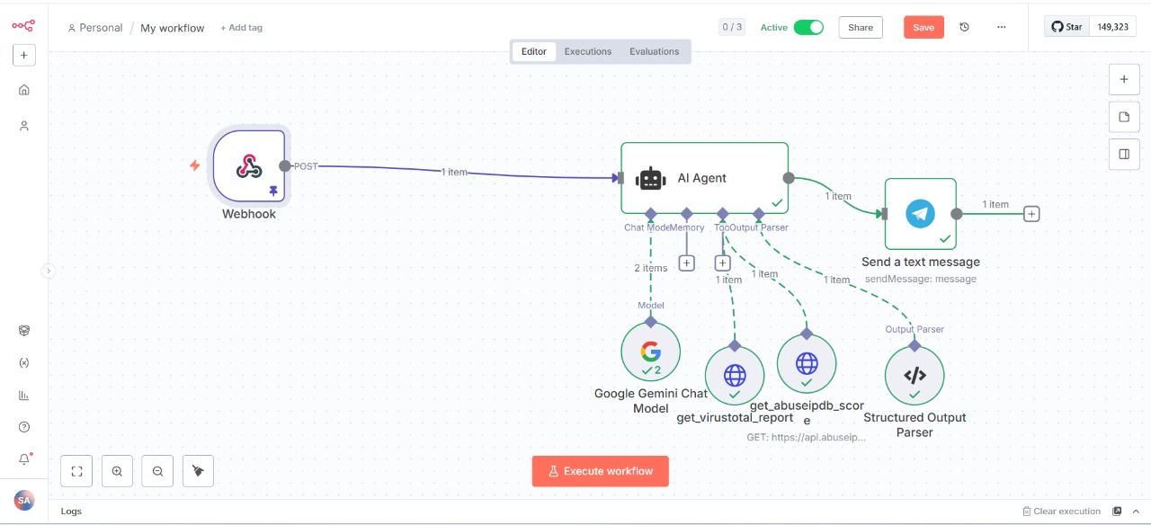
Modelling/Block Diagram/Flow of Project
Notes:
Sustainability and AI
Sustainability is important because it helps meet our needs now and in the future. It includes protecting the environment, reducing pollution, and improving economic and social well-being.
AI can help us achieve sustainability. AI can process data, make predictions, and optimize systems to solve problems like resource management, environmental conservation, and energy efficiency.
Examples:
Smart grids: Reduce energy consumption.
Agriculture: Optimize water and fertilizer use.
Biodiversity: Monitor wildlife to protect biodiversity.
AI is a powerful tool for creating a more sustainable future.

Slide 8
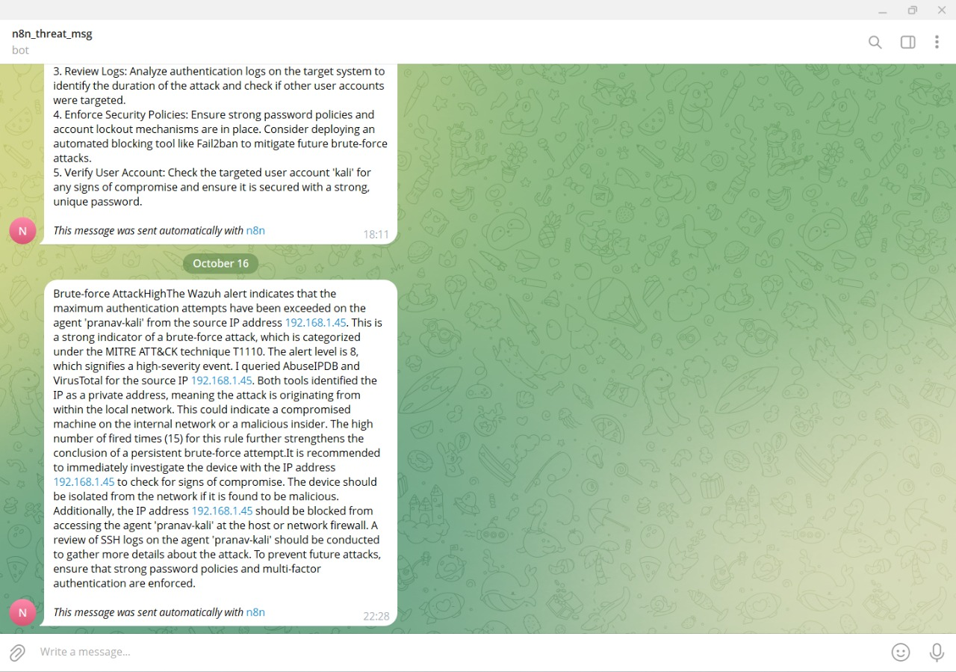
Result/Outcomes
Real-time threat alerts delivered to Telegram.
Improved accuracy of threat detection using multiple intelligence sources.
Significant reduction in manual log analysis time.
Easy-to-read, structured output for faster decision-making.
Notes:
Sustainability and AI
Sustainability is important because it helps meet our needs now and in the future. It includes protecting the environment, reducing pollution, and improving economic and social well-being.
AI can help us achieve sustainability. AI can process data, make predictions, and optimize systems to solve problems like resource management, environmental conservation, and energy efficiency.
Examples:
Smart grids: Reduce energy consumption.
Agriculture: Optimize water and fertilizer use.
Biodiversity: Monitor wildlife to protect biodiversity.
AI is a powerful tool for creating a more sustainable future.

Slide 9
Conclusion
The project provides a fully automated, AI-driven cybersecurity monitoring solution.
Helps security analysts focus on critical incidents rather than manually scanning logs.
Integrates multiple threat intelligence platforms for more reliable detection.
Github link: https://github.com/Pranav-0604/AI-Powered-Cyber-Threat-Monitoring-Alerting-
Notes:
Sustainability and AI
Sustainability is important because it helps meet our needs now and in the future. It includes protecting the environment, reducing pollution, and improving economic and social well-being.
AI can help us achieve sustainability. AI can process data, make predictions, and optimize systems to solve problems like resource management, environmental conservation, and energy efficiency.
Examples:
Smart grids: Reduce energy consumption.
Agriculture: Optimize water and fertilizer use.
Biodiversity: Monitor wildlife to protect biodiversity.
AI is a powerful tool for creating a more sustainable future.

Slide 10
Future Perspective
Expand integration to more threat intelligence platforms.
Add predictive analytics for proactive threat prevention.
Implement dashboard visualization for real-time log monitoring.
Extend system to enterprise-scale networks for broader coverage
Notes:
Sustainability and AI
Sustainability is important because it helps meet our needs now and in the future. It includes protecting the environment, reducing pollution, and improving economic and social well-being.
AI can help us achieve sustainability. AI can process data, make predictions, and optimize systems to solve problems like resource management, environmental conservation, and energy efficiency.
Examples:
Smart grids: Reduce energy consumption.
Agriculture: Optimize water and fertilizer use.
Biodiversity: Monitor wildlife to protect biodiversity.
AI is a powerful tool for creating a more sustainable future.

Slide 11
Thank You
Notes:
Thank You !!

